Slide 1
Verb+ Noun Verb + Infinitive
Basic 7

Slide 2
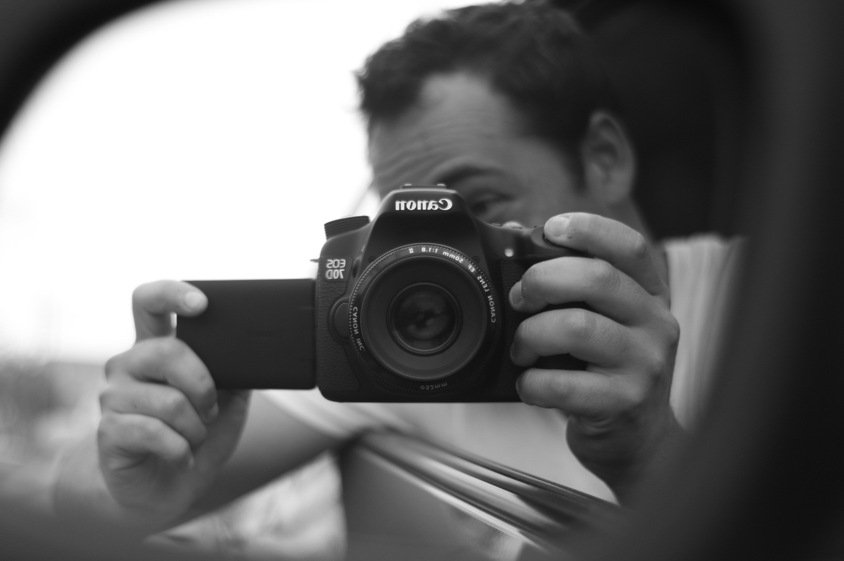
I like photography and I love my camera

Slide 3
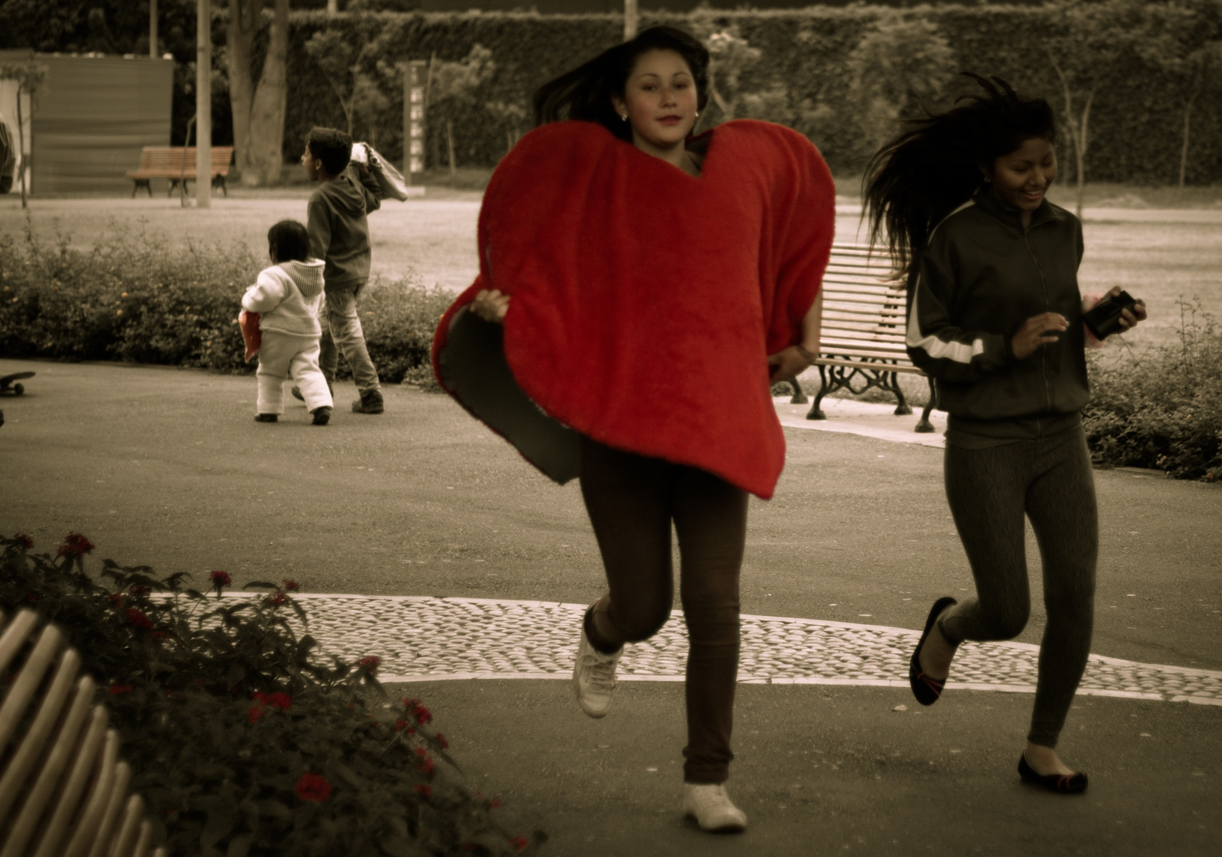

Slide 4
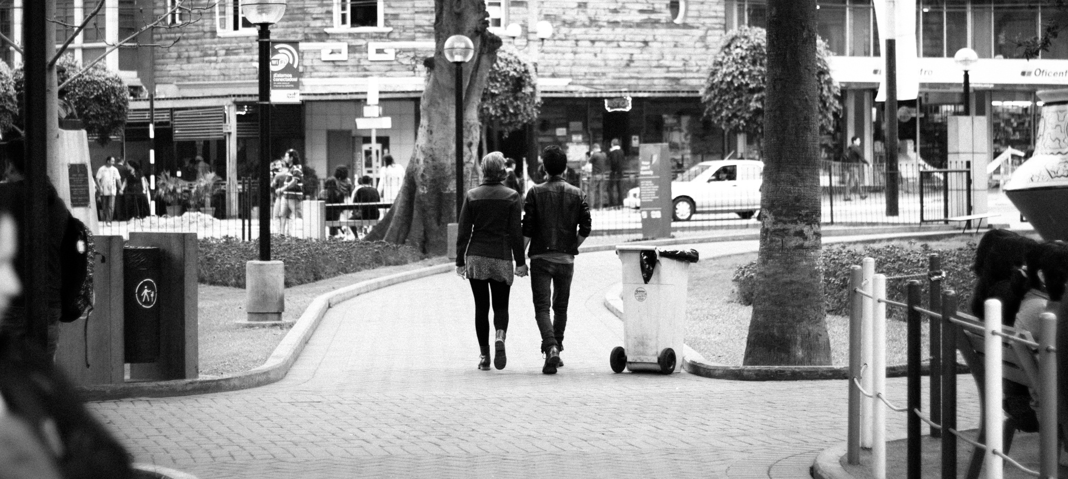

Slide 5
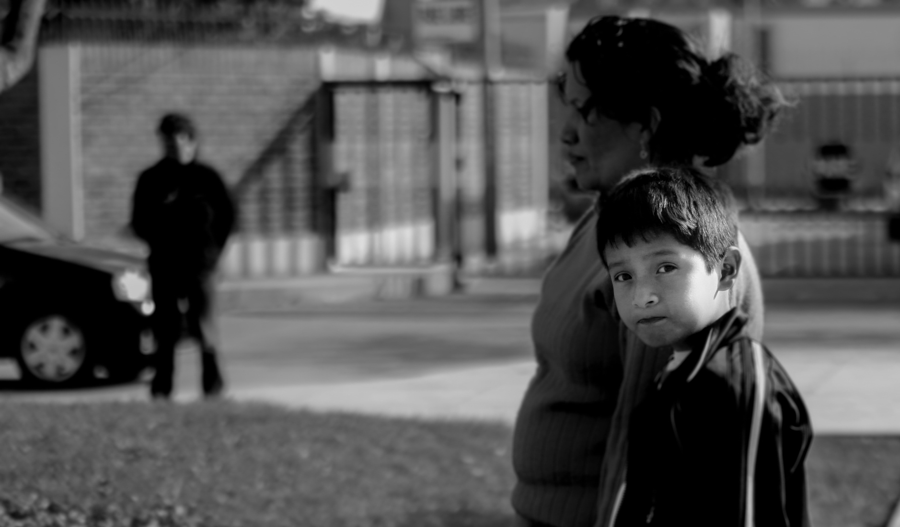

Slide 6
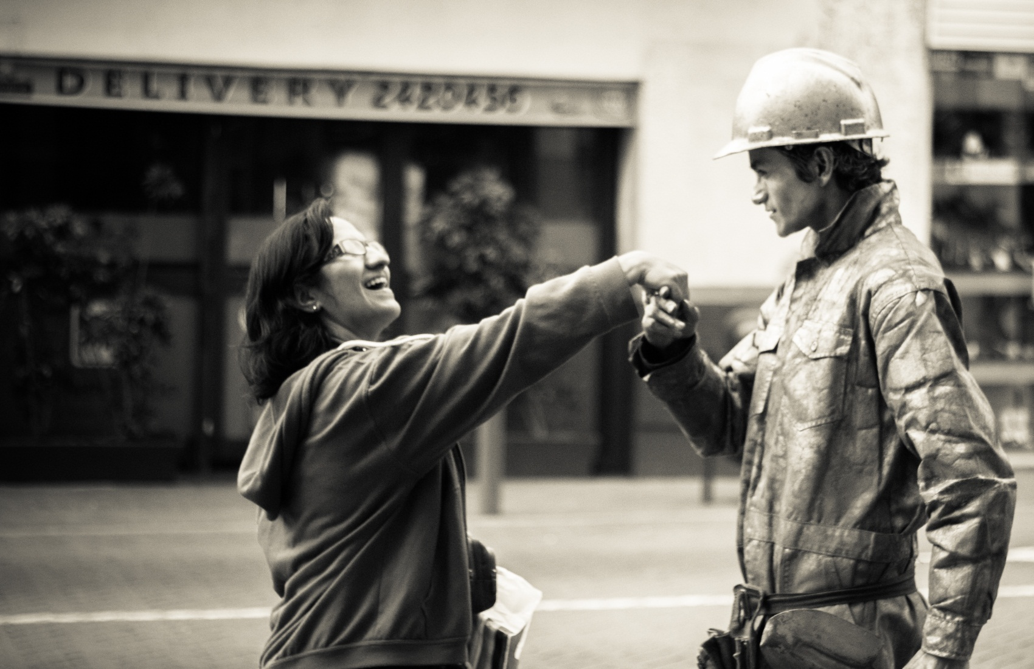
I like to take pictures.

Slide 7
I like photography.
I like to take photos.
I like tennis.
I like to play tennis.

Slide 8
I like
I like
I like
I like
photography.
to take photos.
tennis.
to play tennis.
noun
To + Base Verb (infinitive)
noun
Infinitive (To+Verb)

Slide 9
I like to cake.
I like to swimming.
I like swimming.
I like eat cakes.

Slide 10
What do you like?
What do you like to do in your free time?
What do you hate?
What do you plan to do this year?
What did you learn to do or play last year?

